Slide 1
Progress Report
Yida Zhang
9/13/2024

Slide 2
Outline
Dataset generation

Slide 3
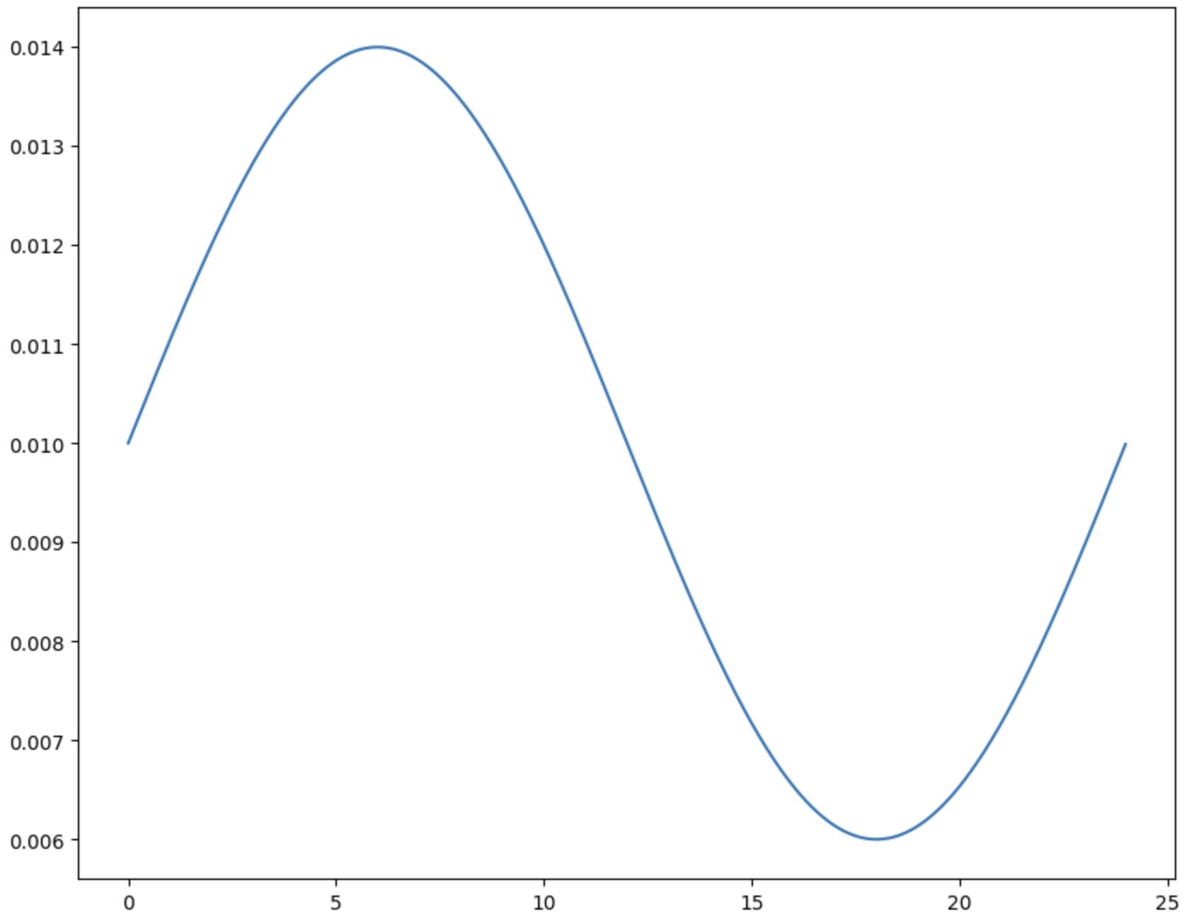
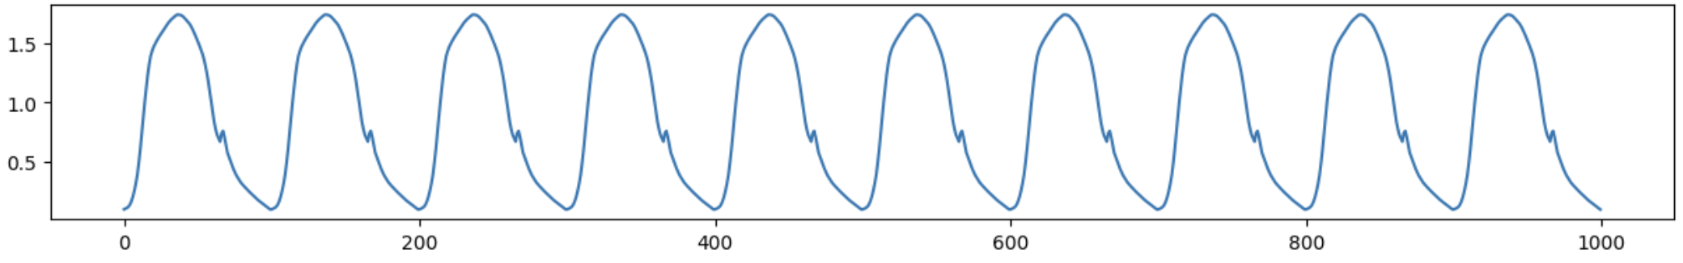
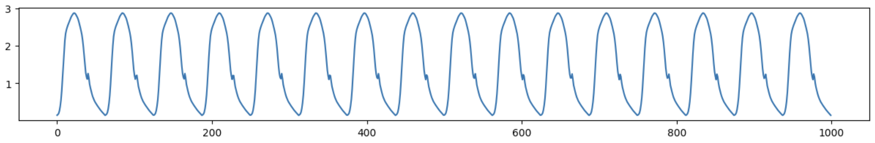
Train and Test dataset separation
Description: Separate the train and test dataset according to the TPR. All the signals with TPR bigger than 0.012 are train set and all the signals with TPR smaller than 0.008 are test set. TPR determines the ratio of the main peak width to the heartbeat cycle width. So in train set, the heartbeat cycles are usually wide and short, while the heartbeat cycles in test set are usually narrow and tall.
Train
Example of train signal (SV=90)
Test
Separation of train and test dataset
Example of test signal (SV=90)

Slide 4
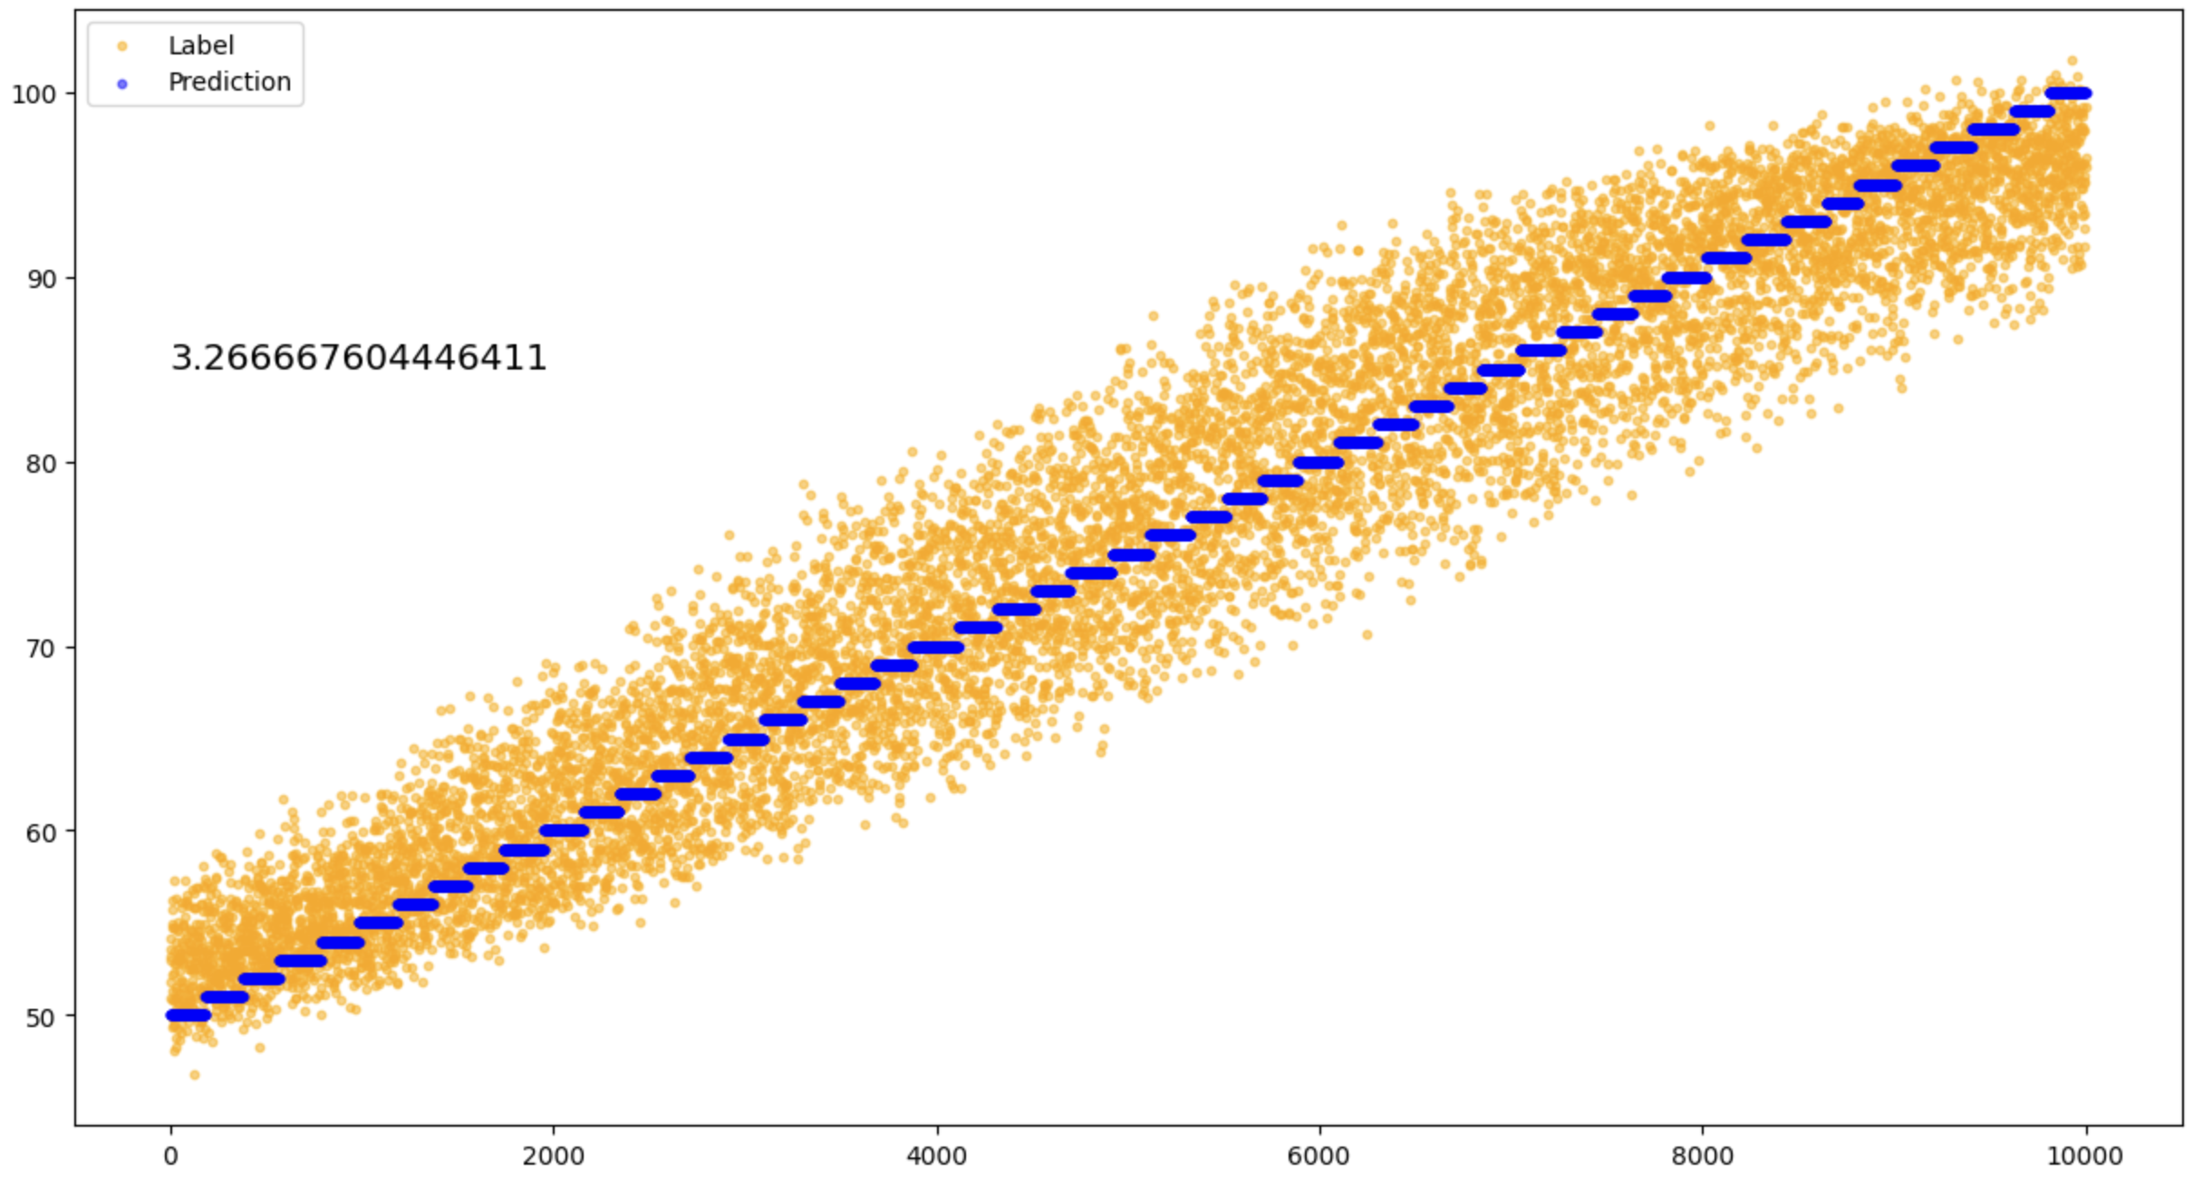
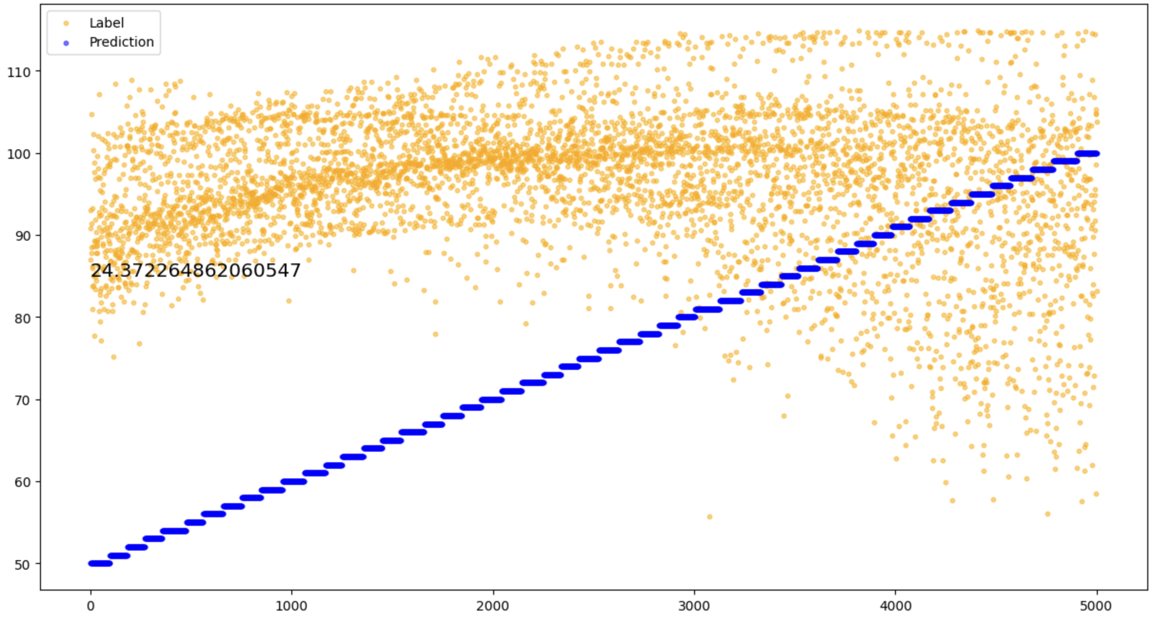
Prediction result using Waveform signal
Prediction result of train set
Prediction result of train set
Notes:
I still try to add noise to the whole part or only to the tail, and separate the dataset as train and test set, the DL can learn well.

Slide 5
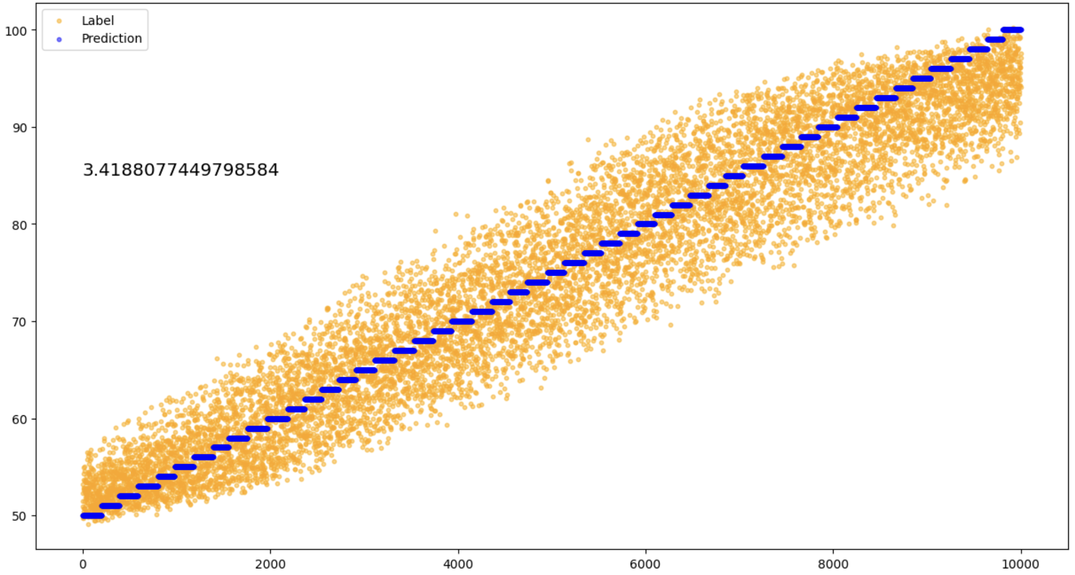
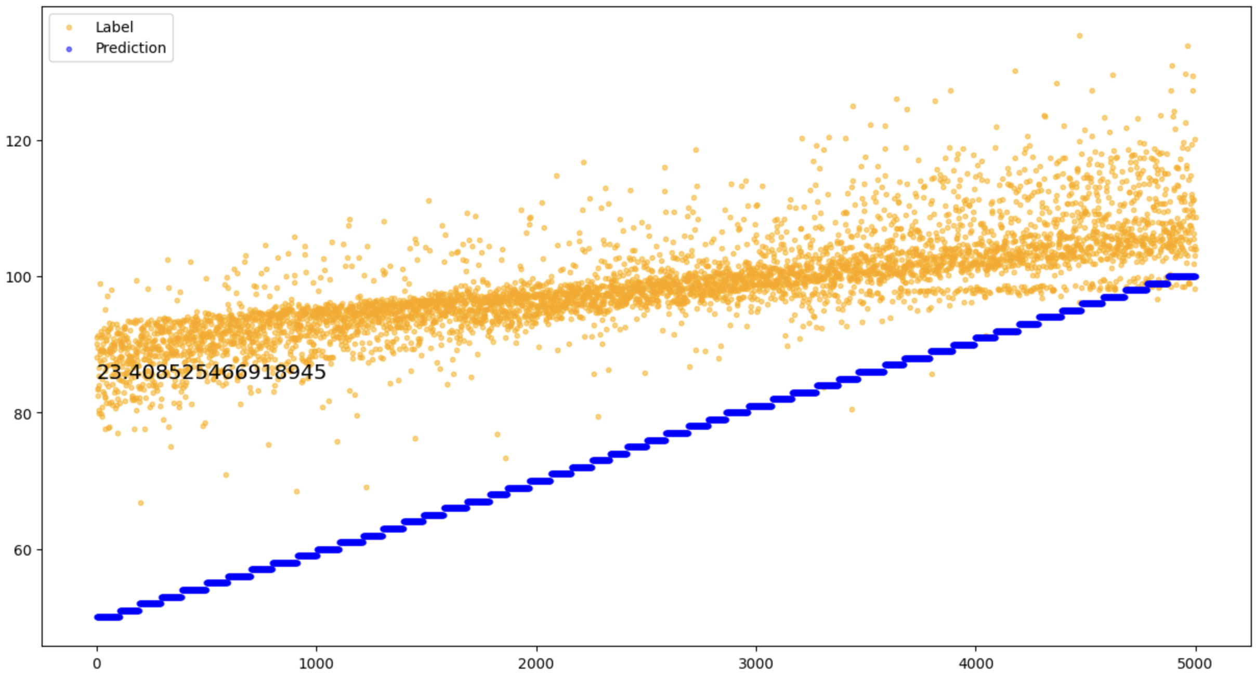
Prediction result using Waveform signal
Prediction result of train set
Prediction result of train set
Conclusion: The working principle of a neural network is interpolation, not extrapolation. Therefore, for an equation Y=F(a, b, c), if the value range of any variable changes between the training set and the test set, it may cause the neural network to not work properly
Notes:
I still try to add noise to the whole part or only to the tail, and separate the dataset as train and test set, the DL can learn well.

Slide 6
Thanks

